Slide 1

IAD/Blockchain Project (Super Brief) Update Oct 14
Stefan-Cristian Roata

Slide 2
Talking Points: Text Translation
Text Translation using the official Google Translate API: I currently depend on prof Hsu to translate the foreign language texts in our dataset. I already sent her a .csv file with the foreign texts only (untruncated), and she did try to run it using her R script and Google API key, but the API stopped because of that super long text that’s over 400k characters.
Because of that, prof Hsu suggested that we truncate (all) the texts to the mean number of characters in all texts (which is around 12558.9 characters).
I have chosen 12558 as a threshold and re-sent her the file so she can run the translator again. I am still waiting for the results on her side, but they are most likely only going to be available next week, since prof Hsu is in Scotland at a conference now.
She already managed to translate 174 (out of the total of 556) foreign texts, but the dataframe she generated contains hundreds of additional columns that are filled with NA’s). I can send it to you (it is in the new Github repo that I created this week).

Slide 3
Talking Points: British to American English
I have not found any python package that does that (even though I searched a lot for it), so I thought to write a function from scratch.
There is a dictionary I found online in json format that I thought would be nice to use, but I would like to hear your opinion on it. Here it is: https://raw.githubusercontent.com/hyperreality/American-British-English-Translator/master/data/british_spellings.json

Slide 4
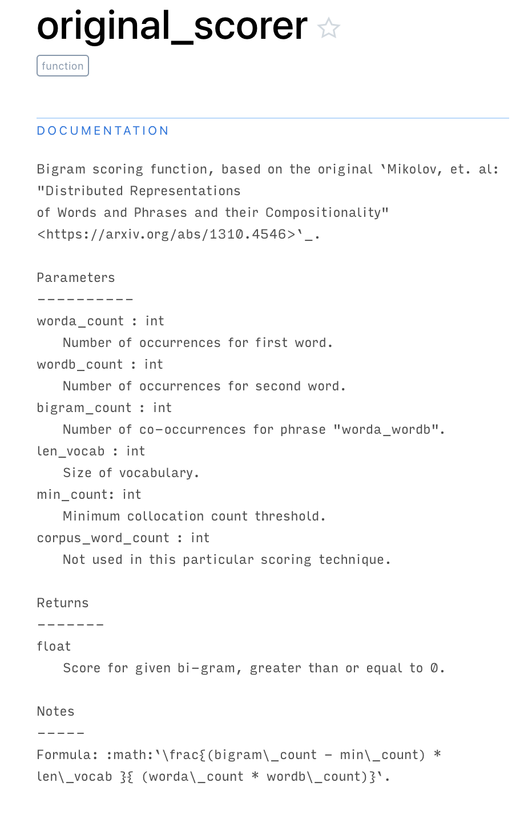
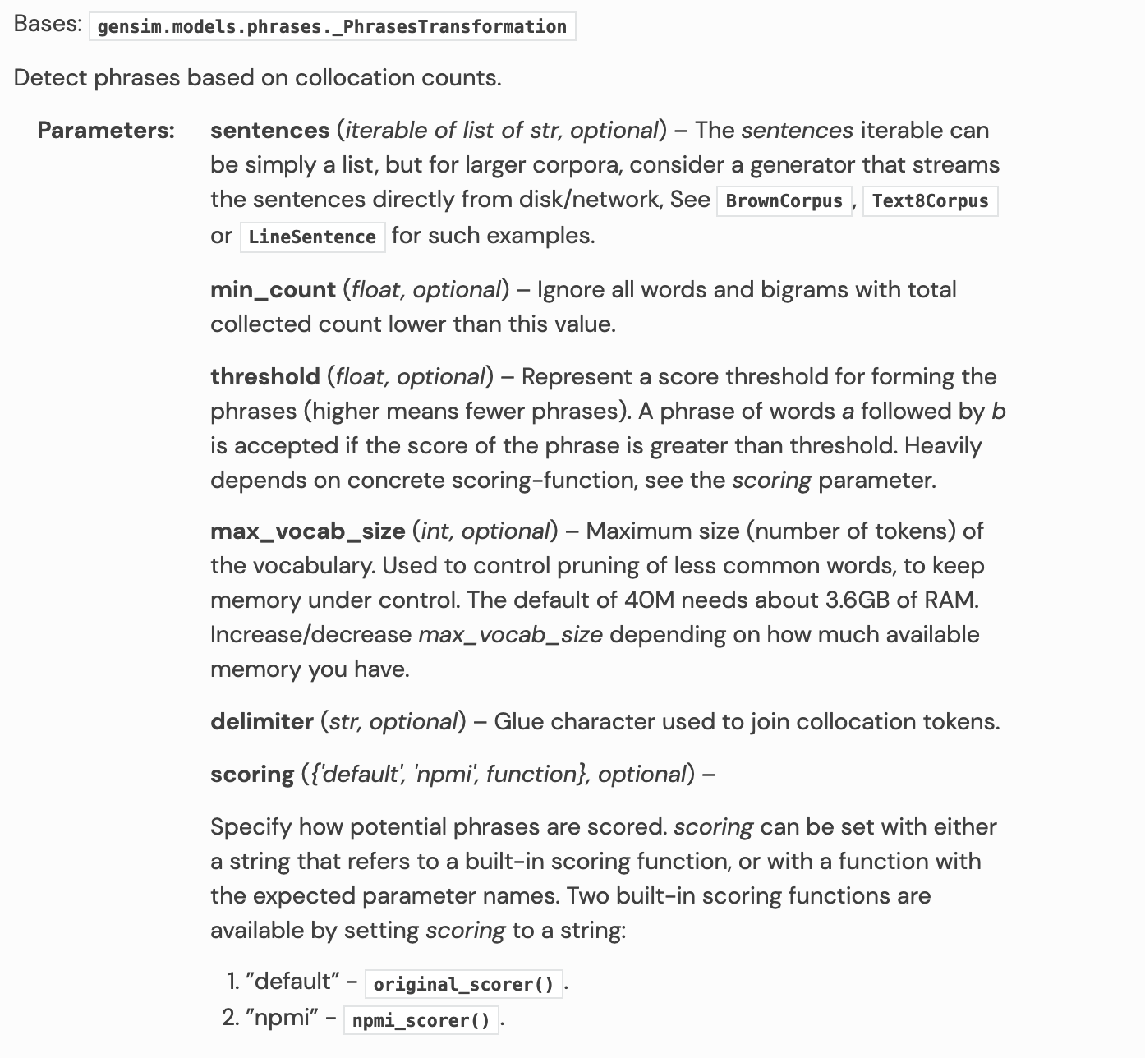
Talking Points: bigram formation and threshold setting

